Slide 1
Query Processing
Chapter 7

Slide 2
Query Processing
Query Processing is expressed in a high level query language such as SQL.
This query must be scanned, parsed and validated before execution.
The scanner identifies the language tokens such as SQL keywords, attributes name, relation name etc.
The parser check the query syntax to determine whether it is formulated according to the syntax rule of query language.
The query must be validating by checking that all attributes and relation names are valid and meaningful according to the schema of the particular database.

Slide 3
Query processing is the procedure of selecting the best plan or strategy to be used in responding to a database request.
The plan is then executed to generate a response.
The component of the DBMS responsible for generating this strategy is called a query processor. It is a stepwise process.
The first step is to transform the query into a standard from.
For example, a query in QBE looked into by the research community. Query may be transformed into a relational algebraic expression; the optimization is performed by substituting equivalent expressions for those in the query.
In the next step a number of strategies called access pans are generated for evaluating the transformed query.
The physical characteristics of the data and any supporting access method are taken into account in generating alternate access pans.
The cost of each access plan is estimated and the optimal one is chosen and executed.

Slide 4
Objective of Query Processing
The aim of query processing is to transform a query written in a high level language into a correct and efficient execution strategy expressed in a low level language and execute the strategy to retrieve the data.

Slide 5
Basic Steps in Query Processing
Query Processing is the activity performed in extracting data from the database.
In query processing, it takes various steps for fetching the data from the database. The steps involved are:
Parsing and translation
Optimization
Evaluation

Slide 6
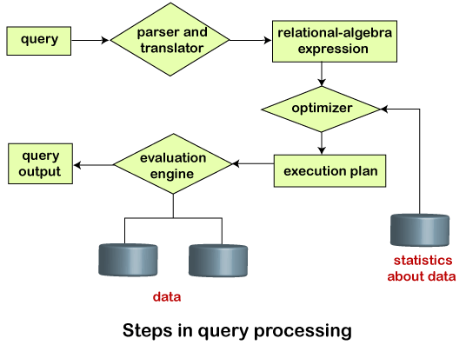
Basic Steps in Query Processing

Slide 7
Parsing and Translation
As query processing includes certain activities for data retrieval. Initially, the given user queries get translated in high-level database languages such as SQL.
It gets translated into expressions that can be further used at the physical level of the file system.
After this, the actual evaluation of the queries and a variety of query -optimizing transformations and takes place.
Thus before processing a query, a computer system needs to translate the query into a human-readable and understandable language.
Notes:
Parsing and translation ● translate the query into its internal form. This is then translated into relational algebra. ● Parser checks syntax, verifies relations

Slide 8
Parsing and Translation
Consequently, SQL or Structured Query Language is the best suitable choice for humans. But, it is not perfectly suitable for the internal representation of the query to the system.
Relational algebra is well suited for the internal representation of a query.
The translation process in query processing is similar to the parser of a query.
When a user executes any query, for generating the internal form of the query, the parser in the system checks the syntax of the query, verifies the name of the relation in the database, the tuple, and finally the required attribute value.
The parser creates a tree of the query, known as 'parse-tree.' Further, translate it into the form of relational algebra. With this, it evenly replaces all the use of the views when used in the query.

Slide 9
2. Evaluation
For this, with addition to the relational algebra translation, it is required to annotate the translated relational algebra expression with the instructions used for specifying and evaluating each operation. Thus, after translating the user query, the system executes a query evaluation plan.
Query Evaluation Plan
In order to fully evaluate a query, the system needs to construct a query evaluation plan.
The annotations in the evaluation plan may refer to the algorithms to be used for the particular index or the specific operations.
Such relational algebra with annotations is referred to as Evaluation Primitives. The evaluation primitives carry the instructions needed for the evaluation of the operation.
Thus, a query evaluation plan defines a sequence of primitive operations used for evaluating a query. The query evaluation plan is also referred to as the query execution plan.
A query execution engine is responsible for generating the output of the given query. It takes the query execution plan, executes it, and finally makes the output for the user query.
Notes:
■ Evaluation ● The query-execution engine takes a query-evaluation plan, executes that plan, and returns the answers to the query.

Slide 10
3. Optimization
The cost of the query evaluation can vary for different types of queries. Although the system is responsible for constructing the evaluation plan, the user does need not to write their query efficiently.
Usually, a database system generates an efficient query evaluation plan, which minimizes its cost. This type of task performed by the database system and is known as Query Optimization.
For optimizing a query, the query optimizer should have an estimated cost analysis of each operation. It is because the overall operation cost depends on the memory allocations to several operations, execution costs, and so on.
Finally, after selecting an evaluation plan, the system evaluates the query and produces the output of the query.

Slide 11
Suppose a user executes a query. As we have learned that there are various methods of extracting the data from the database. In SQL, a user wants to fetch the records of the employees whose salary is greater than or equal to 10000. For doing this, the following query is undertaken:
select emp_name from Employee where salary>10000;
Thus, to make the system understand the user query, it needs to be translated in the form of relational algebra. We can bring this query in the relational algebra form as:
σ_{salary>10000} (π_{salary} (Employee))
π_{salary} (σ_{salary>10000} (Employee))
After translating the given query, we can execute each relational algebra operation by using different algorithms. So, in this way, a query processing begins its working.

Slide 12
A relational algebra expression may have many equivalent expressions
E.g., σ_{balance<2500}(∏_{balance}(account)) is equivalent to ∏_{balance}(σ_{balance<2500}(account))
Each relational algebra operation can be evaluated using one of several different algorithms
Correspondingly, a relational-algebra expression can be evaluated in many ways.
Annotated expression specifying detailed evaluation strategy is called an evaluation-plan.
E.g., can use an index on balance to find accounts with balance < 2500,
or perform complete relation scan and discard accounts with balance ≥ 2500

Slide 13
The Query execution engine takes a query-evaluation plan, executes that plan, and returns the answers to the query.
Query Optimization: Amongst all equivalent evaluation plans choose the one with lowest cost.
● Cost is estimated using statistical information from the database catalog e.g. number of tuples in each relation, size of tuples, etc

Slide 14
Alternative ways of evaluating a given query
● Equivalent expressions
● Different algorithms for each operation

Slide 15
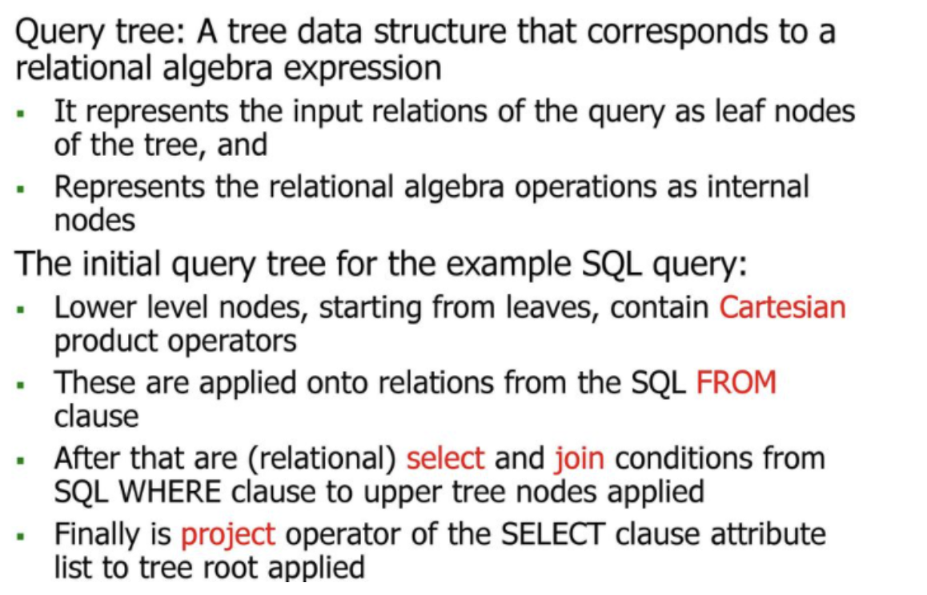
Query Tree

Slide 16
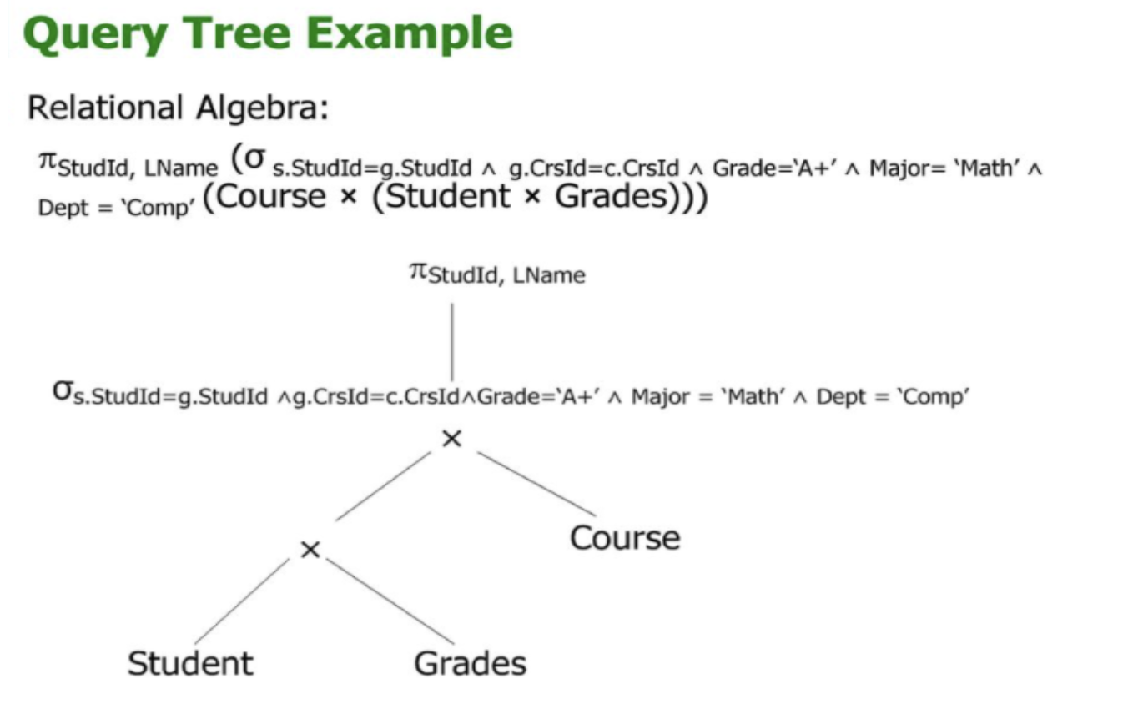

Slide 17
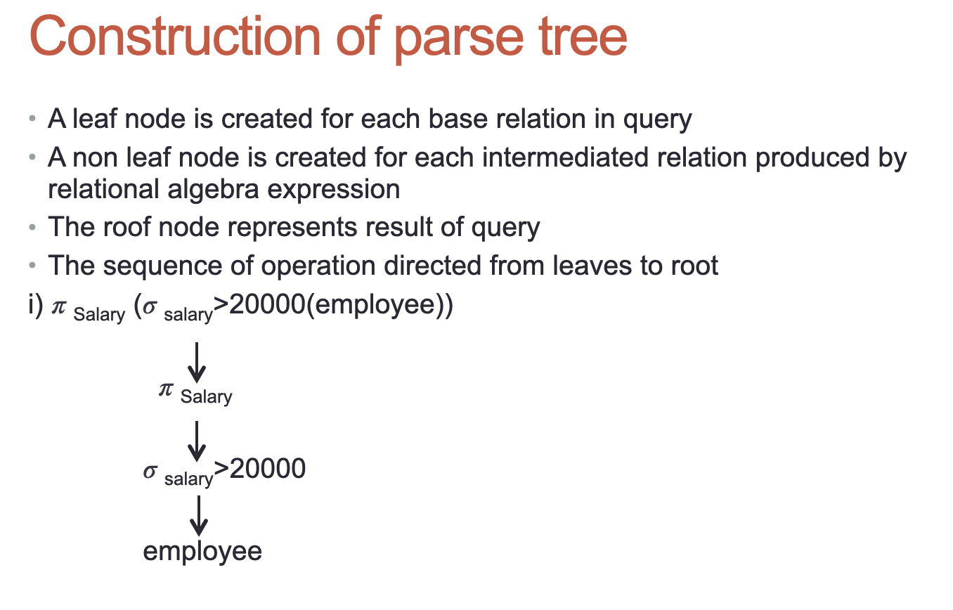

Slide 18
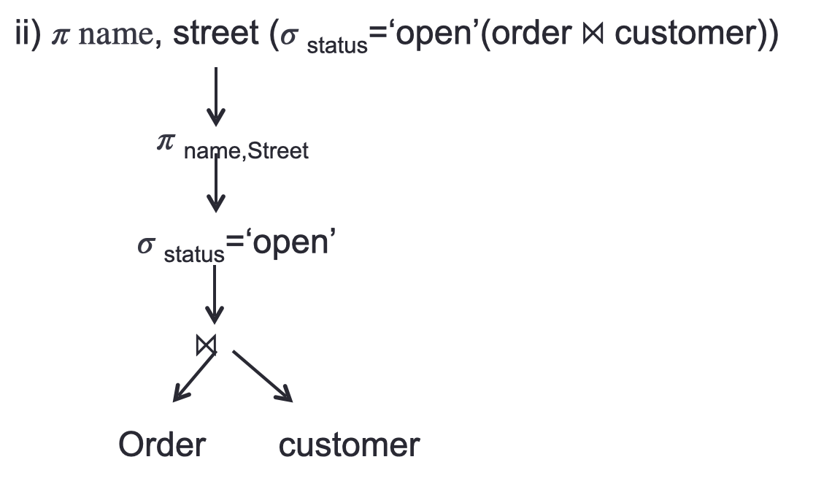

Slide 19
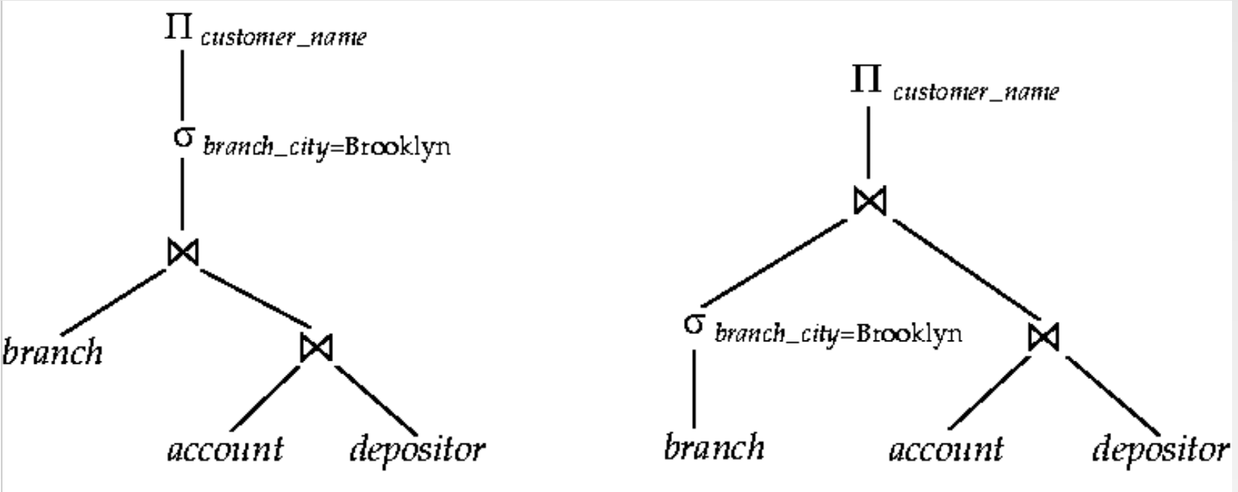
π_{customer_name} (π_{salary} ((σ_{branch_city=”Brooklyn”} (branch )⋈(account ⋈ depositor))
π_{customer_name} (σ_{branch_city=”Brooklyn”} (branch ⋈ account ⋈ depositor ))

Slide 20
Generating Equivalent Expressions
Transformation of Relational Expressions
Two relational algebra expressions are said to be equivalent if the two expressions generate the same set of tuples on every legal database instance
● Note: order of tuples is irrelevant
In SQL, inputs and outputs are multisets of tuples
● Two expressions in the multiset version of the relational algebra are said to be equivalent if the two expressions generate the same multiset of tuples on every legal database instance.
An equivalence rule says that expressions of two forms are equivalent
● Can replace expression of first form by second, or vice versa

Slide 21
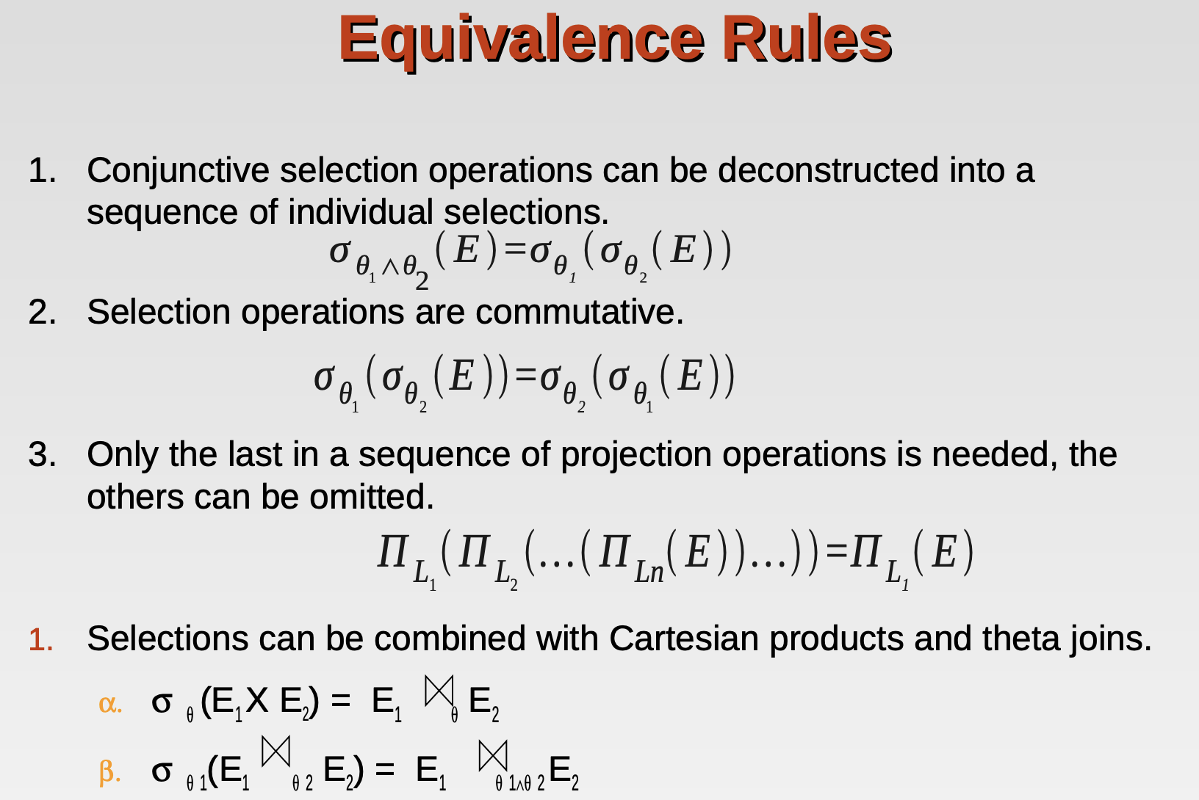

Slide 22
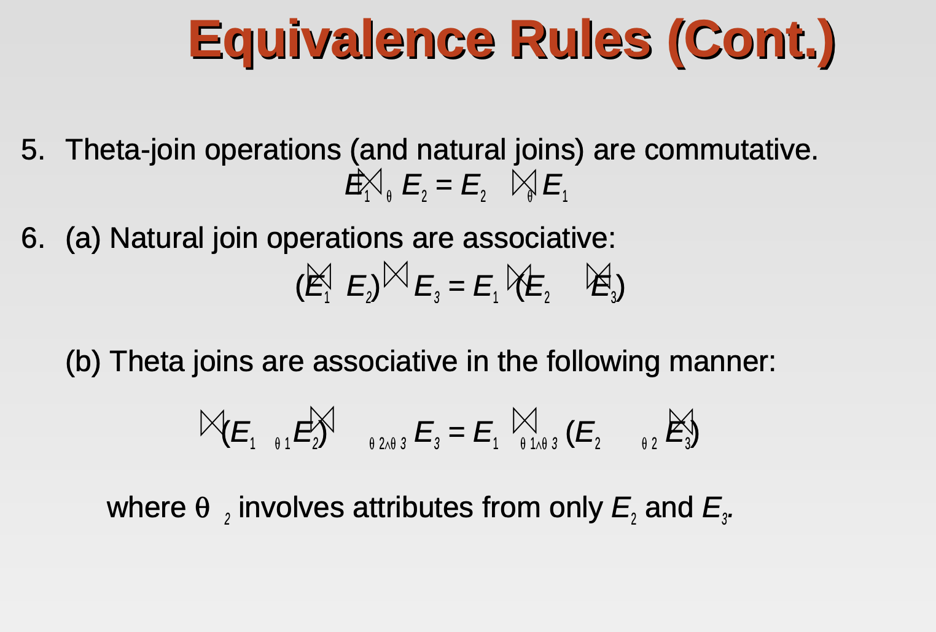

Slide 23
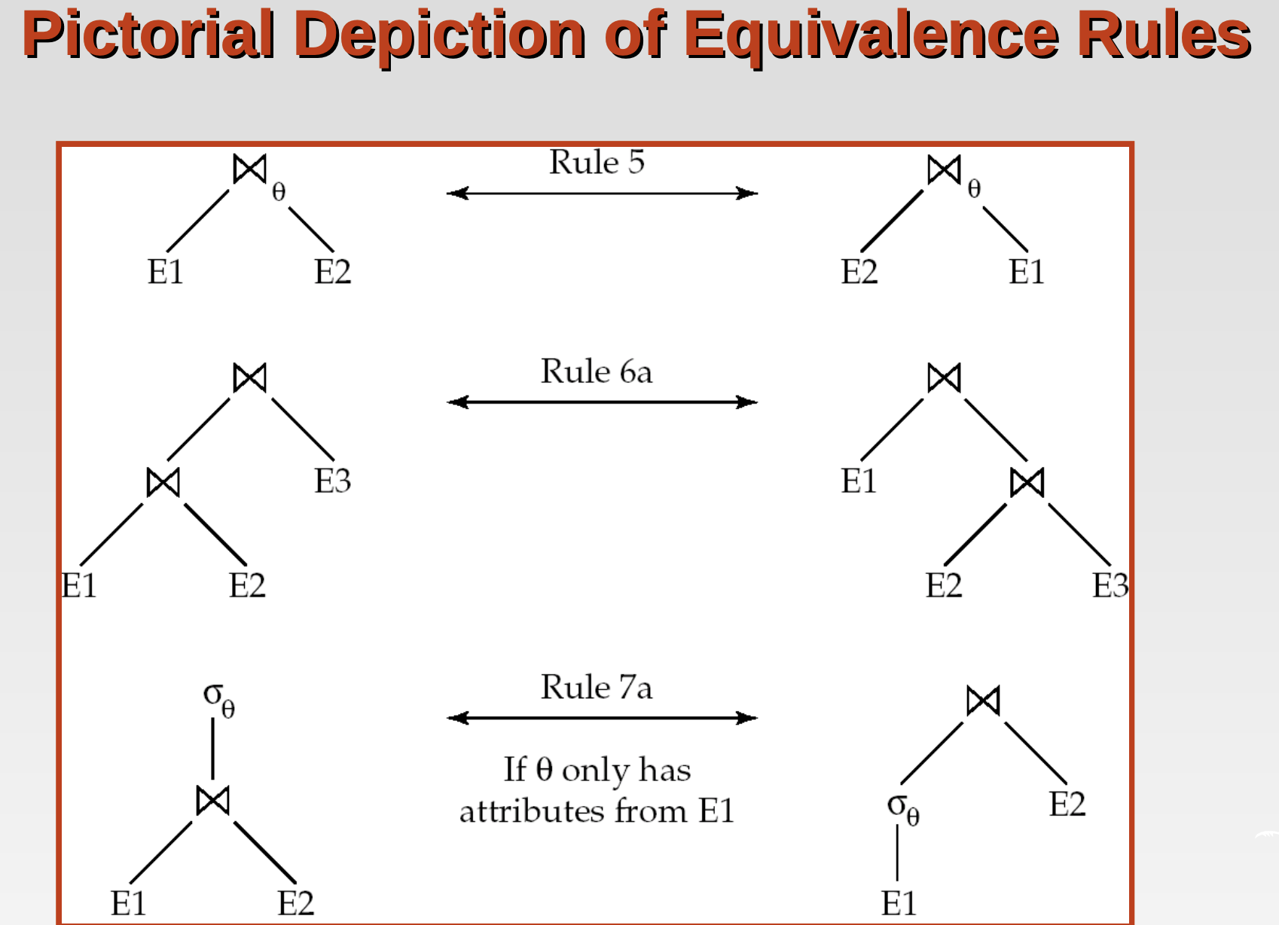

Slide 24
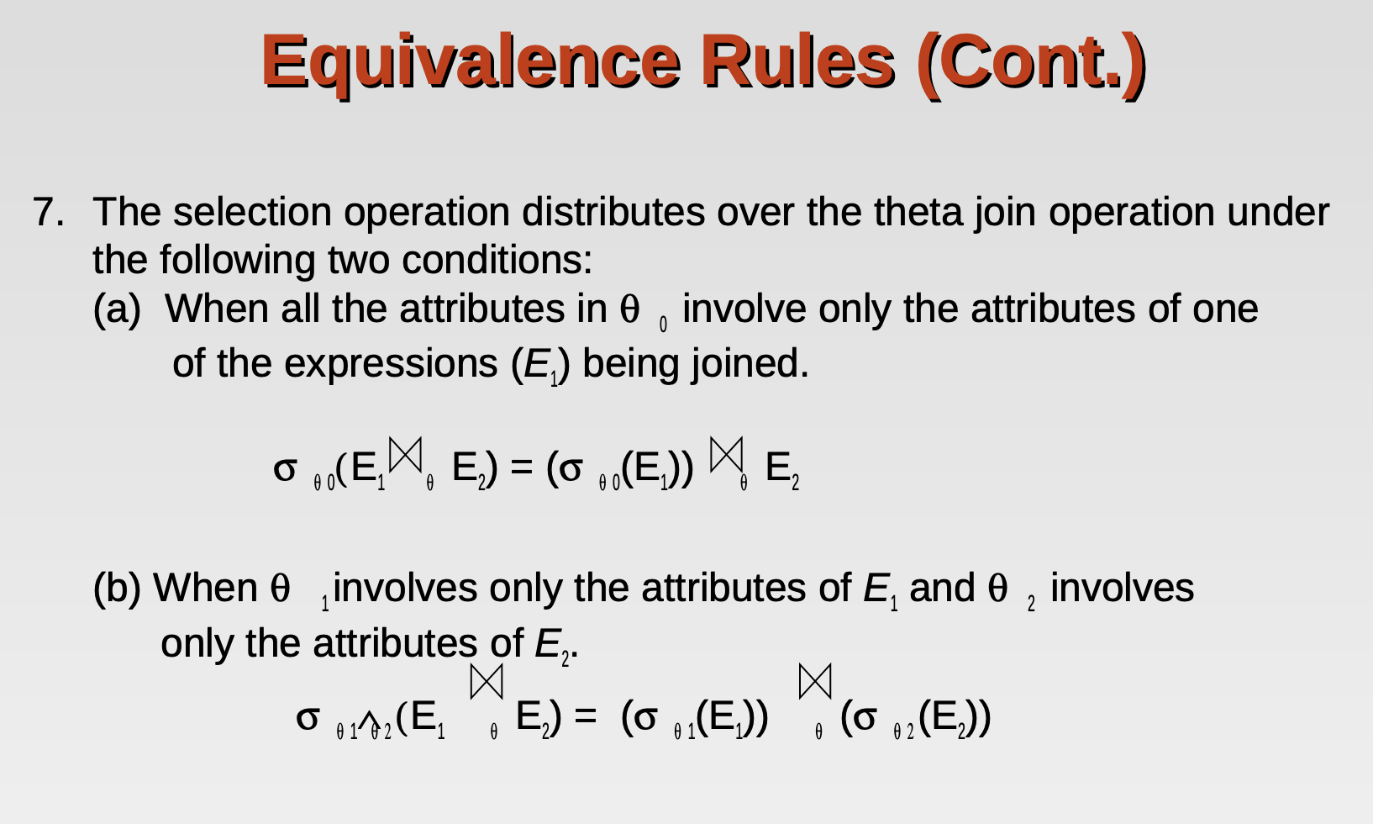

Slide 25
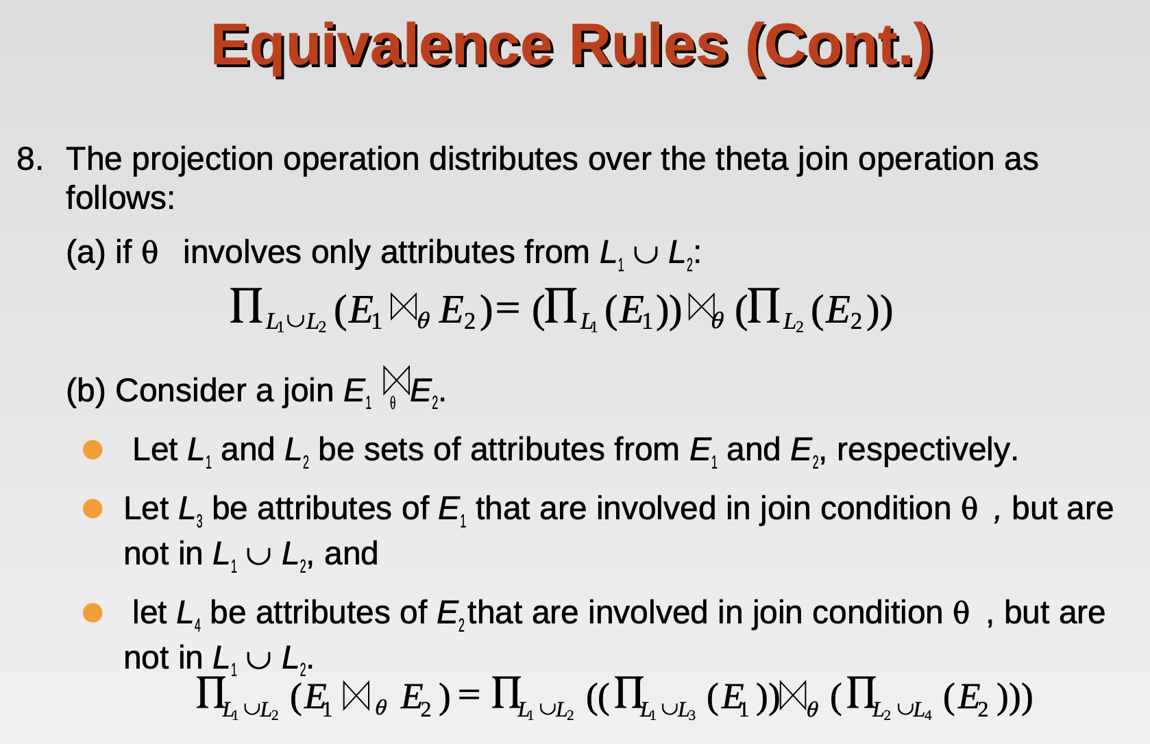

Slide 26
